Slide 1
Exploratory Computer Vision with ALRP

Slide 2
Setup
import matplotlib.pyplot as plt
from skimage.io import imread
from skimage import measure
from skimage.filters import threshold_otsu
from skimage.measure import regionprops
import matplotlib.patches as patches
import numpy as np
from skimage.transform import resize
from PIL import Image
images_dir = 'images/’
labels_dir = 'labels/'
image_name = '0d877fcf8137cfc5'
image = images_dir + image_name + '.jpg’
label = labels_dir + image_name + '.txt'
Import libraries that will be used throughout the project
Point to the image and label directories within the project
Define the image and file name
Put it all together to get the file paths

Slide 3
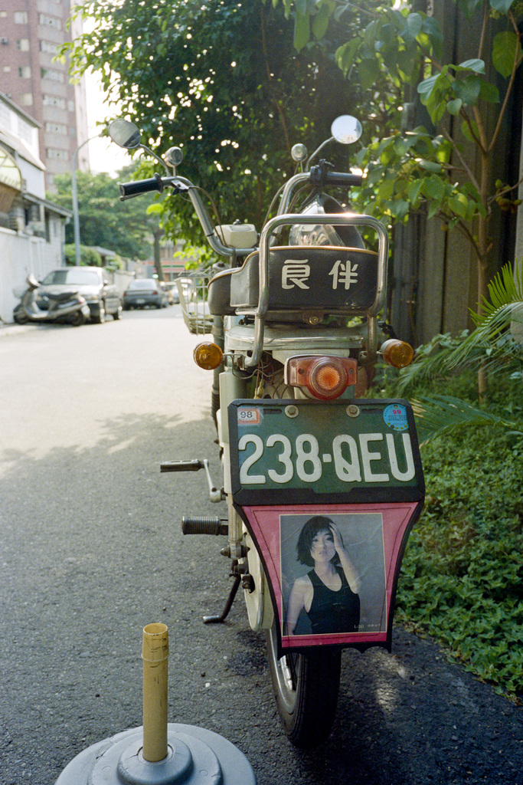
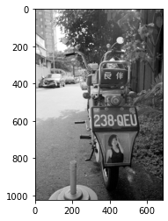
View Source Image
image = imread(image, as_gray=True))
fig, ax1 = plt.subplots(1)
ax1.imshow(image, cmap="gray")
plt.show()
Convert to black and white to standardize vision inputs
Display image by creating a figure and adding it as a subplot
This will be standard methodology throughout
Raw Input
cmap=“gray”

Slide 4
Plate Isolation Read label file
# Read labels
f = open(label, "r")
text = f.read()
# Isolate coordinates
text = text[2:]
Coordinates are defined using YOLO format
Object type
Relative x-center, relative y-center, relative width, relative, height (all in [0,1] format
0 0.621444878477306 0.57140625 0.3846149999999998 0.13437500000000002
X-Center: 0.621444878477306 (62% across)
Y-Center: 0.57140625 (57% across)
X-Width: 0.3846149999999998 (38% width)
Y-Width: 0.13437500000000002 (13% height)

Slide 5
Plate Isolation Read label file
rel_x_center = float(coords[0])
rel_y_center = float(coords[1])
rel_width = float(coords[2])
rel_height = float(coords[3])
# Get image dimensions
image_height = image.shape[0]
image_width = image.shape[1]
#Convert relative values [0, 1] to defined pixel positions
plate_center_x = image_width * rel_x_center
plate_center_y = image_height * rel_y_center
plate_width = image_width * rel_width
plate_height = image_height * rel_height
Pull the YOLO coordinates into variables
Get the height and width in pixels
Convert the relative percentages into pixel coordinates
Ex. 1000 px wide image with x-center at 50% has an x-center at x = 500 px

Slide 6
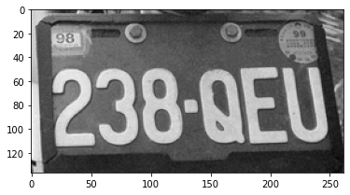
Plate Isolation Read label file
x_offset = plate_width / 2
y_offset = plate_height / 2
#Get plate coordinates
x_min = int(plate_center_x - x_offset)
x_max = int(plate_center_x + x_offset)
y_min = int(plate_center_y - y_offset)
y_max = int(plate_center_y + y_offset)
cropped_image = image[y_min:y_max, x_min:x_max]
Convert height and width to pixels positions
Center +/- half the height/width gives position
Ex: an image with a center at 500 px with a plate width of 250 px has the plate from 375 px to 625 px (500 +/- 250/2)
Crop the image to isolate the plate

Slide 7
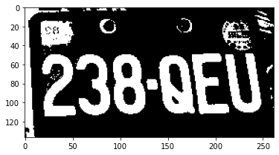
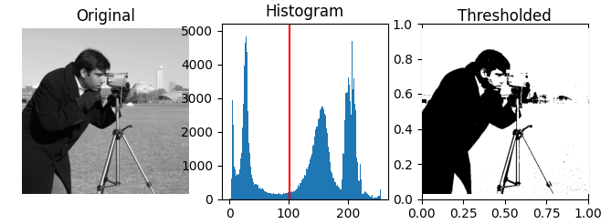
Convert B&W to Binary
threshold_value = threshold_otsu(cropped_image)
# Show binary (thresholded) version of image
binary_image = cropped_image > threshold_value
Thresholding splits each pixel in the image into one of two categories (black or white)
No grayscale
Called a “binary image” because there are only two possible values per pixel
Determines if each value is closer to black or white
Source: https://scikit-image.org/docs/stable/auto_examples/segmentation/plot_thresholding.html

Slide 8
Convert B&W to Binary Invert to standardize
# Count the number of white (1) and black (0) pixels
white_pixels = np.sum(binary_image) # Sum of 1s
black_pixels = binary_image.size - white_pixels # Total pixels - white pixels
if white_pixels > black_pixels:
print("Invert”)
updated_plate = np.invert(binary_image)
else:
updated_plate = binary_image
print(”Don’t invert”)
Goal: have plate numbers show as white and surrounding plate as black
Plates come in many different shades and colors; we want to standardize
Method: count the number of black and white pixels in our binary image
If there are more white pixels than black, assume black text on white background
If more white pixels, invert
Our image:
Don’t invert

Slide 9
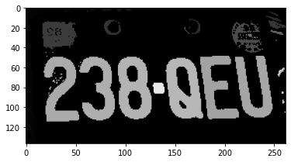
Label Connected Regions
# Label connected regions
labeled_plate = measure.label(updated_plate)
Group “regions” of pixels based on proximity
Large blocks of 1s or 0s will be labeled as a region using skimage.measure

Slide 10
Recognize characters Define constraints
# Define constraint percentages
MIN_REL_LP_HEIGHT = 0.15
MAX_REL_LP_HEIGHT = 0.80
MIN_REL_LP_WIDTH = 0.04
MAX_REL_LP_WIDTH = 0.30
# Define in pixels
min_char_height = plate_height * MIN_REL_LP_HEIGHT
max_char_height = plate_height * MAX_REL_LP_HEIGHT
min_char_width = plate_width * MIN_REL_LP_WIDTH
max_char_width = plate_width * MAX_REL_LP_WIDTH
Define how wide/tall each character should be relative to the plate
Our parameters
15-80% of the height
4-30% of the width
Adjust to make sure we are not including other recognized regions
Convert relative values to pixel values

Slide 11
Recognize characters Algorithm
for regions in regionprops(labeled_plate):
# Define region boundary coordinates
y0, x0, y1, x1 = regions.bbox
region_height = y1 - y0
region_width = x1 - x0
# Check if region meets contraints (possible characters)
if (
region_height > min_char_height and
region_height < max_char_height and
region_width > min_char_width and
region_width < max_char_width
):
Iterate through each recognized region
Get the coordinates, height, and width of the region
Check if the region meets our parameters
min_height < region_height < max_height
min_width < region_width < max_width

Slide 12
Recognize characters Algorithm
# Store recognized characters
characters = []
char_data = []
for regions in regionprops(labeled_plate):
…
# Define region and outline
roi = updated_plate[y0:y1, x0:x1]
rect_border = patches.Rectangle((x0, y0), x1-x0, y1-y0, edgecolor=”red", linewidth=2, fill=False)
ax1.add_patch(rect_border)
# Resize and append to array
resized_char = resize(roi, (20, 20))
characters.append(resized_char)
Initialize two empty arrays for storing data
For matching regions:
Define a cropped version of the image that just includes the region
Add a red border to the outside (for user insight)
Resize to a standard 20x20 size
Add the cropped version to the first array
…continued

Slide 13
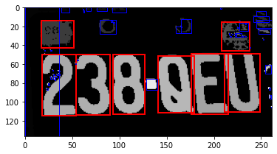
Recognize characters Algorithm
for regions in regionprops(labeled_plate):
…
# Store area for later filtering and x0 for unique ID
char_area = region_height * region_width
char_data.append((char_area, x0))
else:
rect_border = patches.Rectangle((x0, y0), x1-x0, y1-y0, edgecolor="blue", linewidth=1, fill=False)
ax1.add_patch(rect_border)
For matching regions (continued):
Add a tuple with the area and x-coordinate to the second array
This allows us to uniquely identify each region later on
For non-matching regions:
Add a thin blue outline to distinguish it
Don’t save anywhere

Slide 14
Recognize characters Standardizing
[[0. 0. 0. 0. 1. 1. 1. 1. 1. 1. 1. 1. 1. 0. 0. 0. 0. 0. 0. 0.] [0. 1. 1. 1. 1. 1. 1. 1. 1. 1. 1. 1. 1. 1. 1. 0. 0. 0. 0. 0.] [0. 1. 1. 1. 1. 1. 1. 1. 1. 1. 1. 1. 1. 1. 1. 1. 0. 0. 0. 0.] [1. 1. 1. 1. 1. 1. 0. 0. 0. 0. 0. 1. 1. 1. 1. 1. 1. 0. 0. 0.] [1. 1. 1. 1. 1. 0. 0. 0. 0. 0. 0. 0. 1. 1. 1. 1. 1. 1. 0. 0.] [1. 1. 1. 1. 1. 0. 0. 0. 0. 0. 0. 0. 1. 1. 1. 1. 1. 1. 0. 0.] [0. 1. 1. 1. 1. 1. 0. 0. 0. 0. 0. 0. 1. 1. 1. 1. 1. 1. 0. 0.] [0. 1. 1. 1. 1. 1. 0. 0. 0. 0. 0. 1. 1. 1. 1. 1. 1. 1. 0. 0.] [0. 1. 1. 1. 1. 1. 1. 1. 1. 1. 1. 1. 1. 1. 1. 1. 1. 0. 0. 0.] [0. 0. 1. 1. 1. 1. 1. 1. 1. 1. 1. 1. 1. 1. 1. 1. 1. 0. 0. 0.] [0. 1. 1. 1. 1. 1. 1. 1. 1. 1. 1. 1. 1. 1. 1. 1. 1. 1. 1. 0.] [0. 1. 1. 1. 1. 1. 1. 0. 0. 0. 0. 0. 0. 1. 1. 1. 1. 1. 1. 0.] [0. 1. 1. 1. 1. 1. 0. 0. 0. 0. 0. 0. 0. 0. 1. 1. 1. 1. 1. 1.] [0. 1. 1. 1. 1. 1. 0. 0. 0. 0. 0. 0. 0. 0. 1. 1. 1. 1. 1. 1.] [0. 1. 1. 1. 1. 1. 0. 0. 0. 0. 0. 0. 0. 0. 1. 1. 1. 1. 1. 1.] [0. 1. 1. 1. 1. 1. 1. 0. 0. 0. 0. 0. 0. 0. 1. 1. 1. 1. 1. 1.] [0. 1. 1. 1. 1. 1. 1. 1. 0. 0. 0. 0. 0. 1. 1. 1. 1. 1. 1. 1.] [0. 0. 1. 1. 1. 1. 1. 1. 1. 1. 1. 1. 1. 1. 1. 1. 1. 1. 1. 0.] [0. 0. 0. 0. 1. 1. 1. 1. 1. 1. 1. 1. 1. 1. 1. 1. 1. 1. 0. 0.] [0. 0. 0. 0. 0. 0. 0. 1. 1. 1. 1. 1. 1. 1. 1. 0. 0. 0. 0. 0.]]
Resizing to 20x20 standardizes the shape of characters
Converting to binary (and inverting) simplifies into black and white
Stored as 2-dimensional array consisting of 1s and 0s

Slide 15
Recognize characters Standardizing
[[0. 0. 0. 0. 1. 1. 1. 1. 1. 1. 1. 1. 1. 0. 0. 0. 0. 0. 0. 0.] [0. 1. 1. 1. 1. 1. 1. 1. 1. 1. 1. 1. 1. 1. 1. 0. 0. 0. 0. 0.] [0. 1. 1. 1. 1. 1. 1. 1. 1. 1. 1. 1. 1. 1. 1. 1. 0. 0. 0. 0.] [1. 1. 1. 1. 1. 1. 0. 0. 0. 0. 0. 1. 1. 1. 1. 1. 1. 0. 0. 0.] [1. 1. 1. 1. 1. 0. 0. 0. 0. 0. 0. 0. 1. 1. 1. 1. 1. 1. 0. 0.] [1. 1. 1. 1. 1. 0. 0. 0. 0. 0. 0. 0. 1. 1. 1. 1. 1. 1. 0. 0.] [0. 1. 1. 1. 1. 1. 0. 0. 0. 0. 0. 0. 1. 1. 1. 1. 1. 1. 0. 0.] [0. 1. 1. 1. 1. 1. 0. 0. 0. 0. 0. 1. 1. 1. 1. 1. 1. 1. 0. 0.] [0. 1. 1. 1. 1. 1. 1. 1. 1. 1. 1. 1. 1. 1. 1. 1. 1. 0. 0. 0.] [0. 0. 1. 1. 1. 1. 1. 1. 1. 1. 1. 1. 1. 1. 1. 1. 1. 0. 0. 0.] [0. 1. 1. 1. 1. 1. 1. 1. 1. 1. 1. 1. 1. 1. 1. 1. 1. 1. 1. 0.] [0. 1. 1. 1. 1. 1. 1. 0. 0. 0. 0. 0. 0. 1. 1. 1. 1. 1. 1. 0.] [0. 1. 1. 1. 1. 1. 0. 0. 0. 0. 0. 0. 0. 0. 1. 1. 1. 1. 1. 1.] [0. 1. 1. 1. 1. 1. 0. 0. 0. 0. 0. 0. 0. 0. 1. 1. 1. 1. 1. 1.] [0. 1. 1. 1. 1. 1. 0. 0. 0. 0. 0. 0. 0. 0. 1. 1. 1. 1. 1. 1.] [0. 1. 1. 1. 1. 1. 1. 0. 0. 0. 0. 0. 0. 0. 1. 1. 1. 1. 1. 1.] [0. 1. 1. 1. 1. 1. 1. 1. 0. 0. 0. 0. 0. 1. 1. 1. 1. 1. 1. 1.] [0. 0. 1. 1. 1. 1. 1. 1. 1. 1. 1. 1. 1. 1. 1. 1. 1. 1. 1. 0.] [0. 0. 0. 0. 1. 1. 1. 1. 1. 1. 1. 1. 1. 1. 1. 1. 1. 1. 0. 0.] [0. 0. 0. 0. 0. 0. 0. 1. 1. 1. 1. 1. 1. 1. 1. 0. 0. 0. 0. 0.]]
Resizing to 20x20 standardizes the shape of characters
Converting to binary (and inverting) simplifies into black and white
Stored as 2-dimensional array consisting of 1s and 0s

Slide 16
Recognize characters Standardizing
[[0. 0. 0. 0. 1. 1. 1. 1. 1. 1. 1. 1. 1. 0. 0. 0. 0. 0. 0. 0.] [0. 1. 1. 1. 1. 1. 1. 1. 1. 1. 1. 1. 1. 1. 1. 0. 0. 0. 0. 0.] [0. 1. 1. 1. 1. 1. 1. 1. 1. 1. 1. 1. 1. 1. 1. 1. 0. 0. 0. 0.] [1. 1. 1. 1. 1. 1. 0. 0. 0. 0. 0. 1. 1. 1. 1. 1. 1. 0. 0. 0.] [1. 1. 1. 1. 1. 0. 0. 0. 0. 0. 0. 0. 1. 1. 1. 1. 1. 1. 0. 0.] [1. 1. 1. 1. 1. 0. 0. 0. 0. 0. 0. 0. 1. 1. 1. 1. 1. 1. 0. 0.] [0. 1. 1. 1. 1. 1. 0. 0. 0. 0. 0. 0. 1. 1. 1. 1. 1. 1. 0. 0.] [0. 1. 1. 1. 1. 1. 0. 0. 0. 0. 0. 1. 1. 1. 1. 1. 1. 1. 0. 0.] [0. 1. 1. 1. 1. 1. 1. 1. 1. 1. 1. 1. 1. 1. 1. 1. 1. 0. 0. 0.] [0. 0. 1. 1. 1. 1. 1. 1. 1. 1. 1. 1. 1. 1. 1. 1. 1. 0. 0. 0.] [0. 1. 1. 1. 1. 1. 1. 1. 1. 1. 1. 1. 1. 1. 1. 1. 1. 1. 1. 0.] [0. 1. 1. 1. 1. 1. 1. 0. 0. 0. 0. 0. 0. 1. 1. 1. 1. 1. 1. 0.] [0. 1. 1. 1. 1. 1. 0. 0. 0. 0. 0. 0. 0. 0. 1. 1. 1. 1. 1. 1.] [0. 1. 1. 1. 1. 1. 0. 0. 0. 0. 0. 0. 0. 0. 1. 1. 1. 1. 1. 1.] [0. 1. 1. 1. 1. 1. 0. 0. 0. 0. 0. 0. 0. 0. 1. 1. 1. 1. 1. 1.] [0. 1. 1. 1. 1. 1. 1. 0. 0. 0. 0. 0. 0. 0. 1. 1. 1. 1. 1. 1.] [0. 1. 1. 1. 1. 1. 1. 1. 0. 0. 0. 0. 0. 1. 1. 1. 1. 1. 1. 1.] [0. 0. 1. 1. 1. 1. 1. 1. 1. 1. 1. 1. 1. 1. 1. 1. 1. 1. 1. 0.] [0. 0. 0. 0. 1. 1. 1. 1. 1. 1. 1. 1. 1. 1. 1. 1. 1. 1. 0. 0.] [0. 0. 0. 0. 0. 0. 0. 1. 1. 1. 1. 1. 1. 1. 1. 0. 0. 0. 0. 0.]]
Resizing to 20x20 standardizes the shape of characters
Converting to binary (and inverting) simplifies into black and white
Stored as 2-dimensional array consisting of 1s and 0s

Slide 17
Recognize characters Filter candidates
# Create array of just areas (tuple 0)
char_areas = np.array([t[0] for t in char_data])
# Get median of areas
area_median = np.median(char_areas)
# Set parameters
minus_allowed = .10
plus_allowed = .15
max_allowed = area_median * (1 + plus_allowed)
min_allowed = area_median * (1 - minus_allowed)
Isolate the areas from candidate regions into an array
Take the median
Determine variance allowed from the median for candidates
In our example, the area can be 10% below the median or 15% above it
Define area minimum and maximums based on variance

Slide 18
Recognize characters Filter candidates
# Create placeholder array
filtered_characters = []
# Filter both char_data and characters together by mapping with zip
for candidate, character in zip(char_data, characters):
candidate_area = candidate[0]
if min_allowed < candidate_area < max_allowed:
print(candidate_area, "\tAllowed")
filtered_characters.append(character)
else:
print(candidate_area, "\tExcluded")
Initialize an empty array
Iterate through the array of character images and the corresponding data
zip allows us to iterate through them together
If the area is within our constraints, allow it
If not, exclude it

Slide 19
Recognize characters Filter candidates
Areas: [1015 930 2496 2356 2340 2304 2142 2318]
Median: 2311.0
Allowed Range: 2079.9 - 2657.6499999999996
Print outputs
1015 Excluded
930 Excluded
2496 Allowed
2356 Allowed
2340 Allowed
2304 Allowed
2142 Allowed
2318 Allowed

Slide 20
Recognize characters

Slide 21
Isolated
Binary
Original
Grayscale
Regions
Marked
End Result

